Slide 1
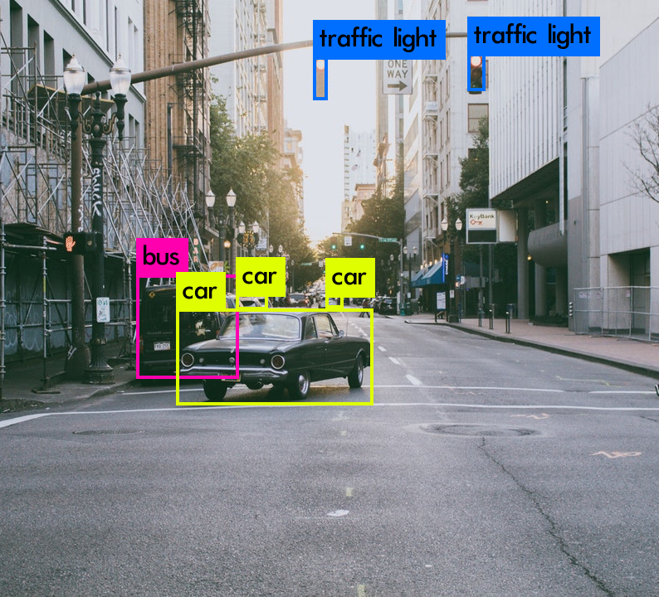
YOLO
You Only Look Once
Bennis Zineb
Debbagh yasmine
Doré Maxime
Jacquiet Morgane
Pillard Cécile
5GMM

Slide 2
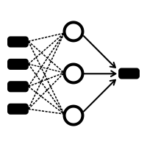
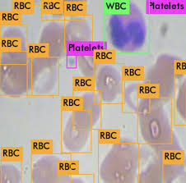

Outline
1. Yolo algorithm
2. Yolo in Practice

Slide 3
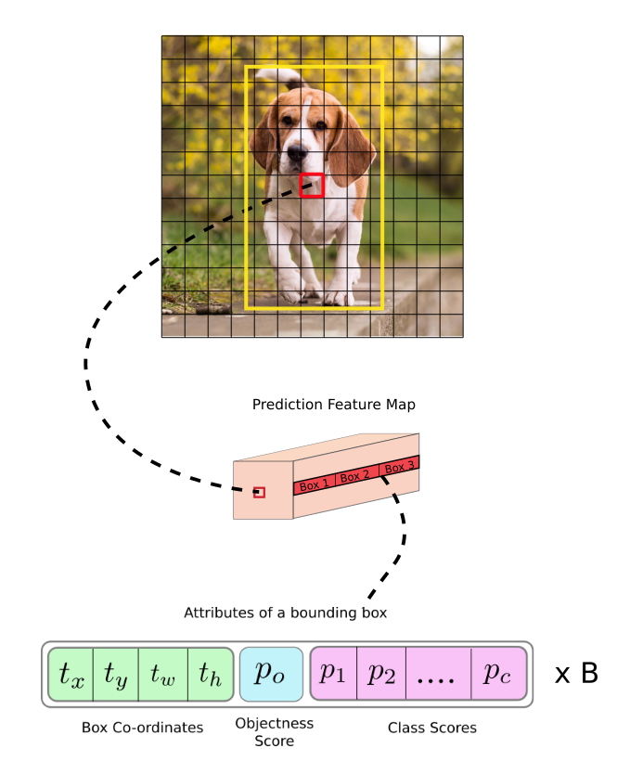
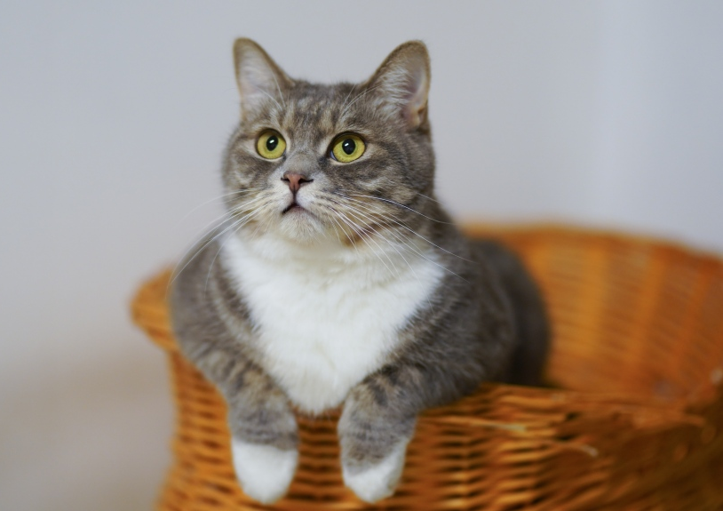
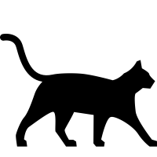

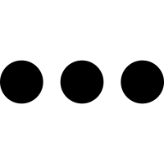


1. Yolo Algorithm
a. Principle
cat
98%
0.7
Yolo v3
0.03
0.2
0.001

Slide 4

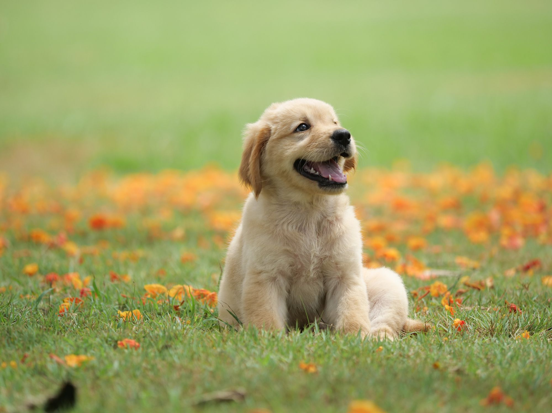
1. Yolo Algorithm
For each grid cell, put 3 anchor boxes
(b_{x},b_{y})
1
2
3

Slide 5
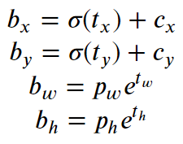
1. Yolo Algorithm
Zoom on anchor boxes
Output
(c_{x},c_{y}) = (0,0)
0
1
2
3
(b_{x},b_{y})
1
2
σ = Fonction Sigmoid
Ρ_{h,} Ρ_{w} = Anchor Dimension
3
→ Déterminés par K-Means par les auteurs et fixés

Slide 6
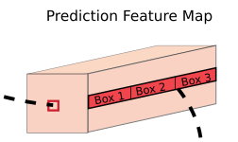

1. Yolo Algorithm
3 predicted boxes for each cell
Box i :
13 x 13 x 3
+ 26 x 26 x 3
+ 52 x 52 x 3
= 10 647 predicted boxes
Yolo v3

Slide 7

1. Yolo Algorithm
Filter boxes with detected object : non-max suppression
Intersection over Union

Slide 8
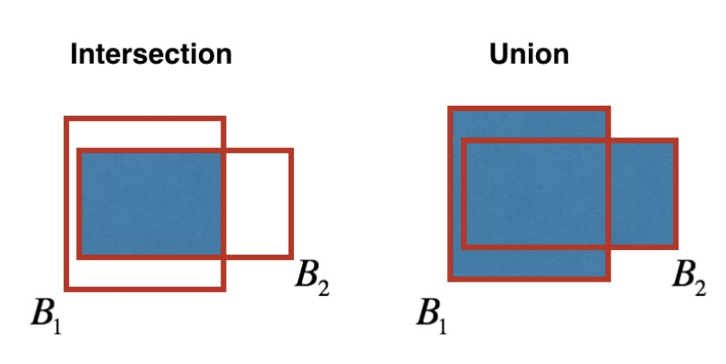
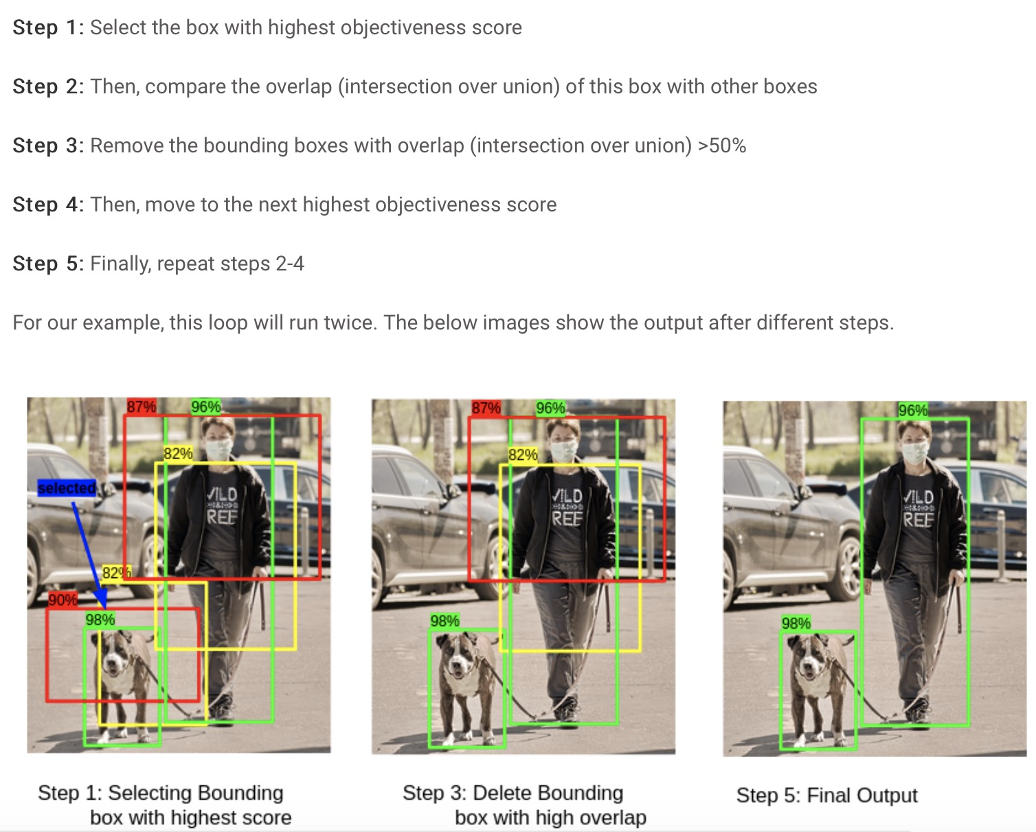
1. Yolo Algorithm
Intersection over Union

Slide 9
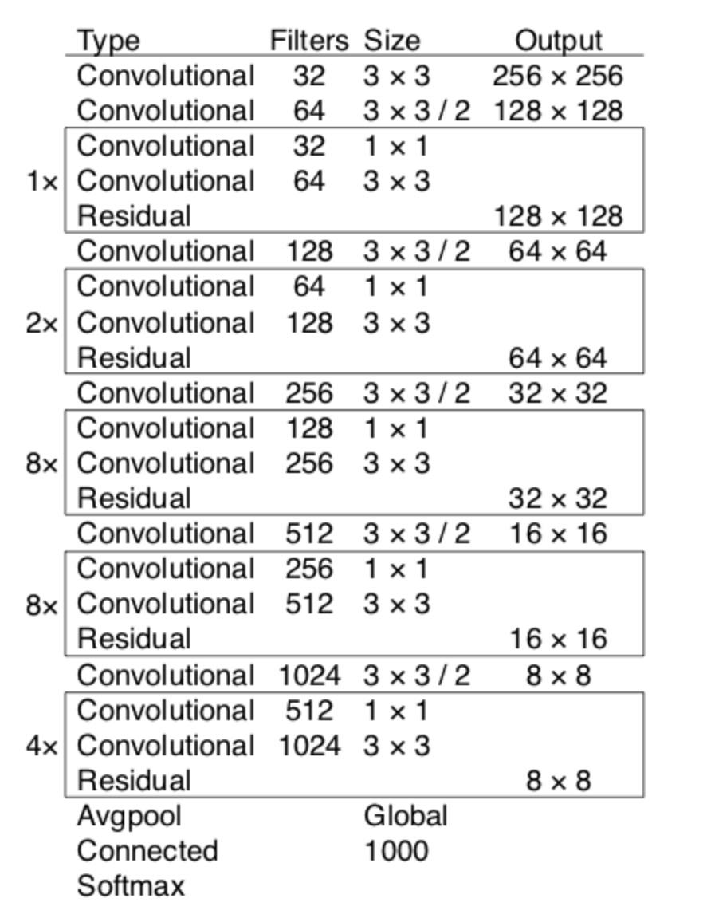
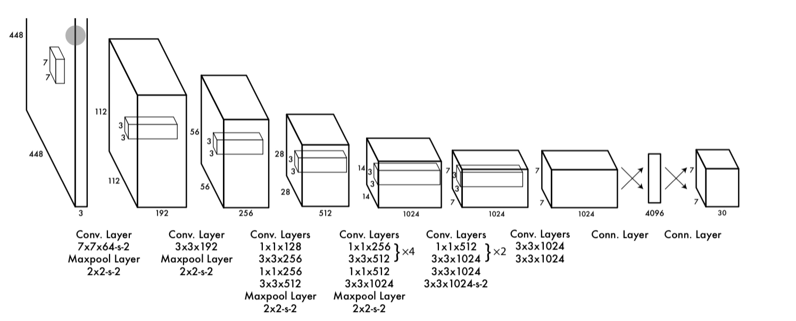
1. Yolo Algorithm
The Darknet-53 network
b. Architecture
DarkNet has 53 convolutional layers each followed by :
batch normalization
Leaky ReLu

Slide 10
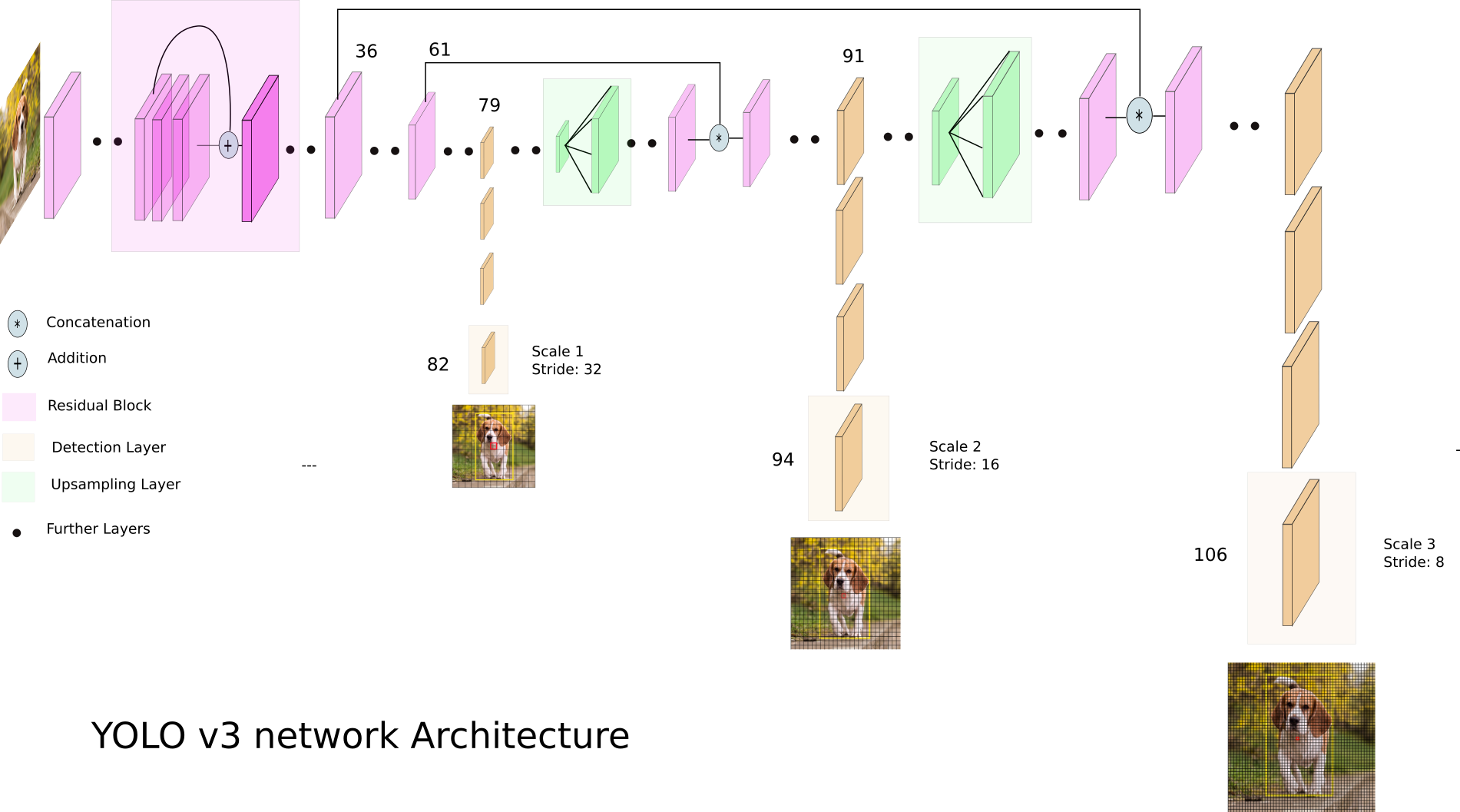
1. Yolo Algorithm
The Darknet-53 network

Slide 11
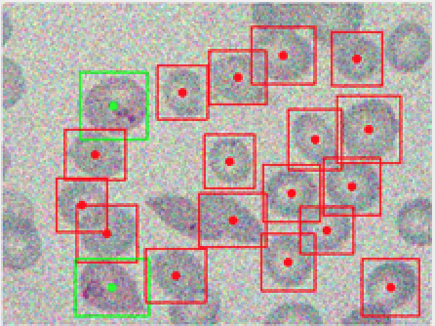

2- In practice
Image:
Image from microscope
Object:
Biological cells (7 categories)
Real image

Slide 12
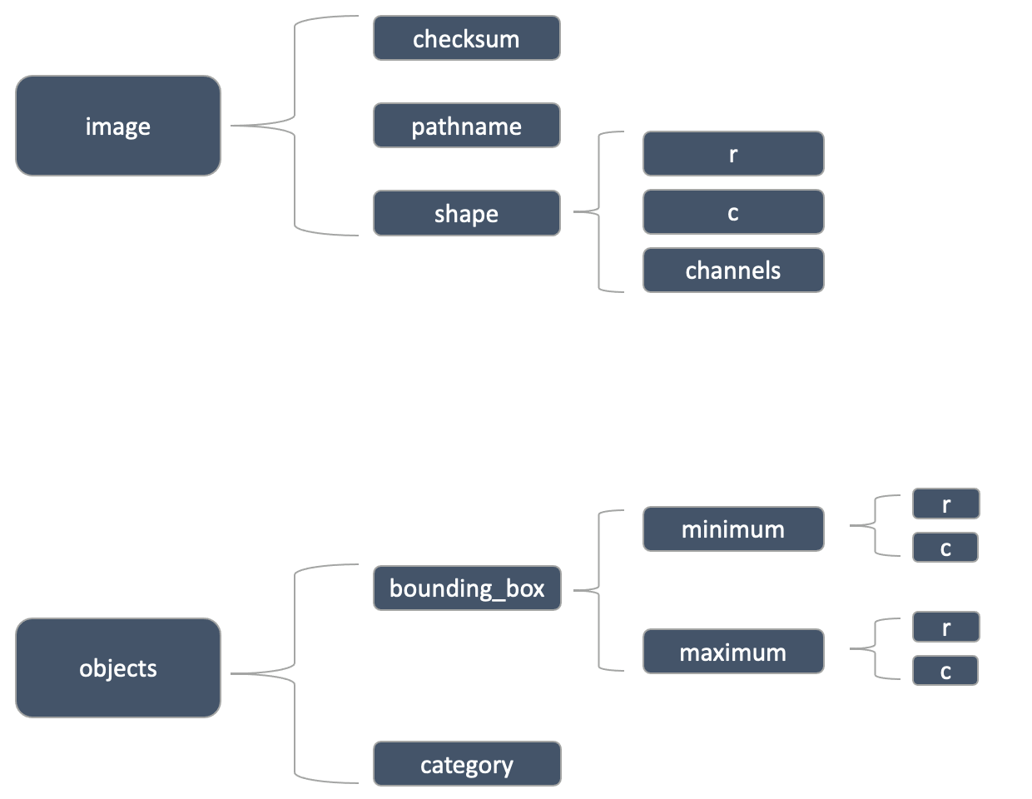
2- In practice
Prepare_labels
Adapt the structure of the training dataset to the YOLO format
Diversify the dataset

Slide 13
2- In practice
Neural Networks :
Convolutionnal
Use of residuals connections

Slide 14
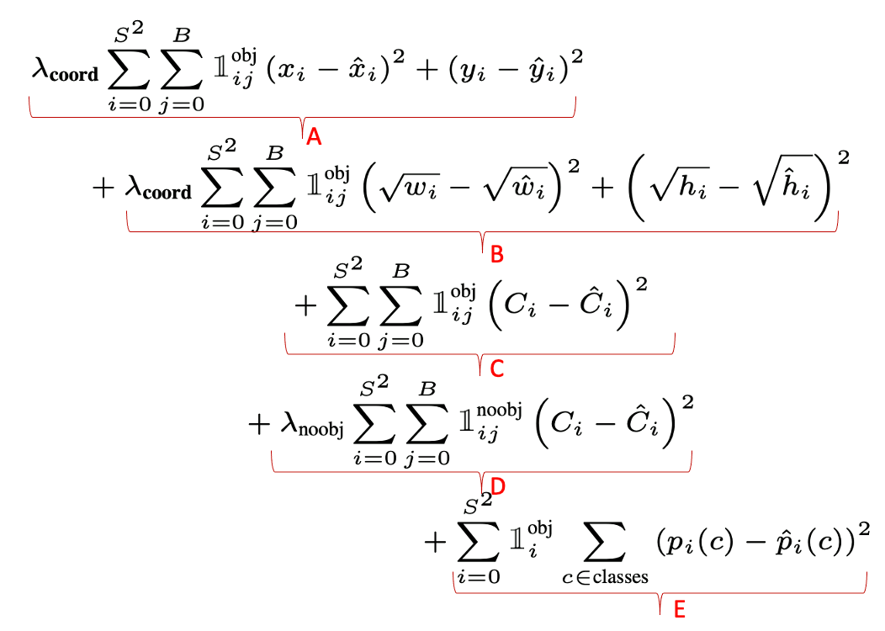
2- In practice
Neural Networks :
Convolutionnal
Use of residuals connections
How YOLO Learn ?

Slide 15
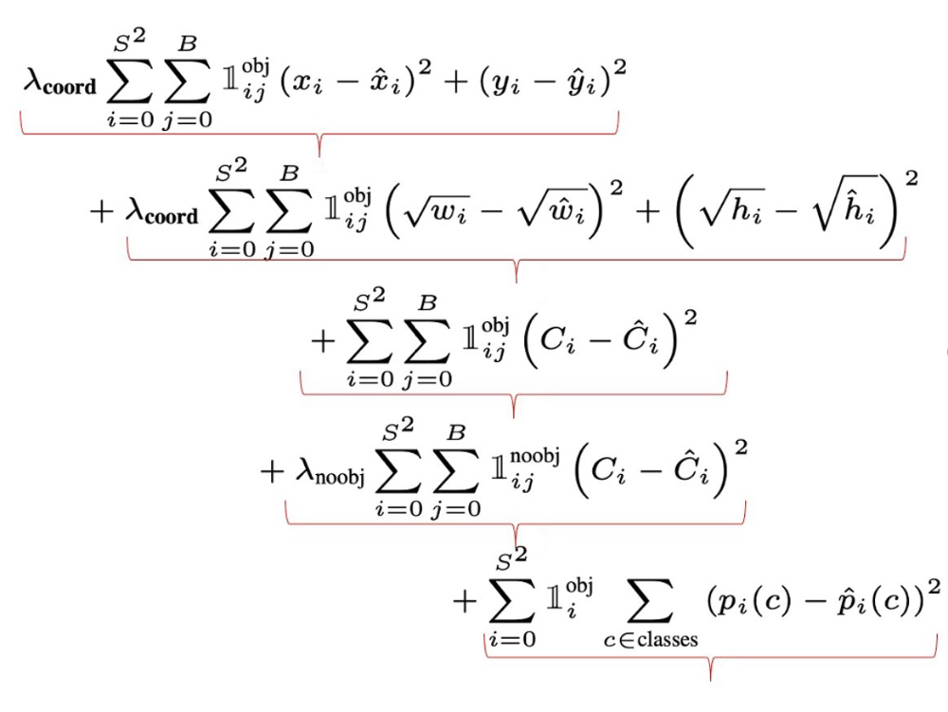
2- In practice
Neural Networks :
Convolutionnal
Use of residuals connections
How YOLO Learn ?

Slide 16
2- In practice
Neural Networks :
Convolutionnal
Use of residuals connections
How YOLO Learn ?
A
B
C
D
E

Slide 17
2- In practice
Neural Networks :
Convolutionnal
Use of residuals connections
How YOLO Learn ?
A
B
C
D
E

Slide 18
2- In practice
Neural Networks :
Convolutionnal
Use of residuals connections
How YOLO Learn ?
A
B
C
D
E

Slide 19
2- In practice
Neural Networks :
Convolutionnal
Use of residuals connections
How YOLO Learn ?
A
B
C
D
E

Slide 20
2- In practice
Neural Networks :
Convolutionnal
Use of residuals connections
How YOLO Learn ?
A
B
C
D
E

Slide 21
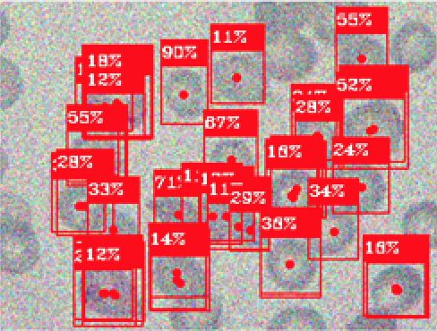

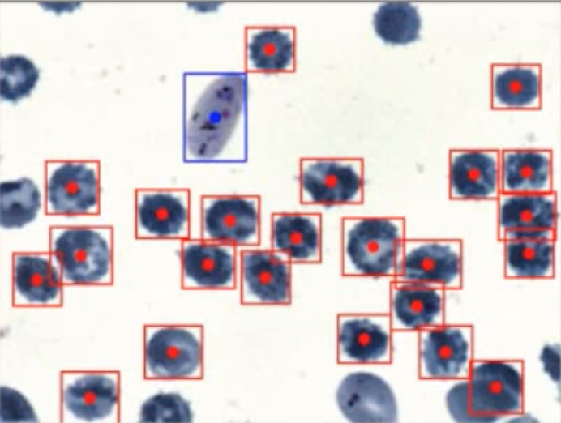
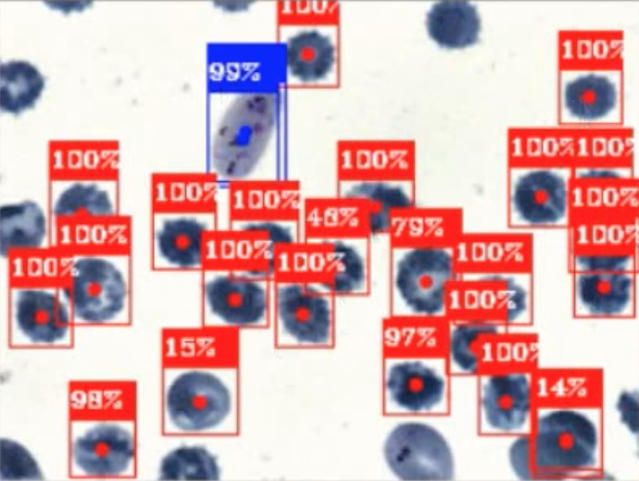
2- In practice
What results ?
YOLO
(few training)
YOLO
(With more training)

Slide 22
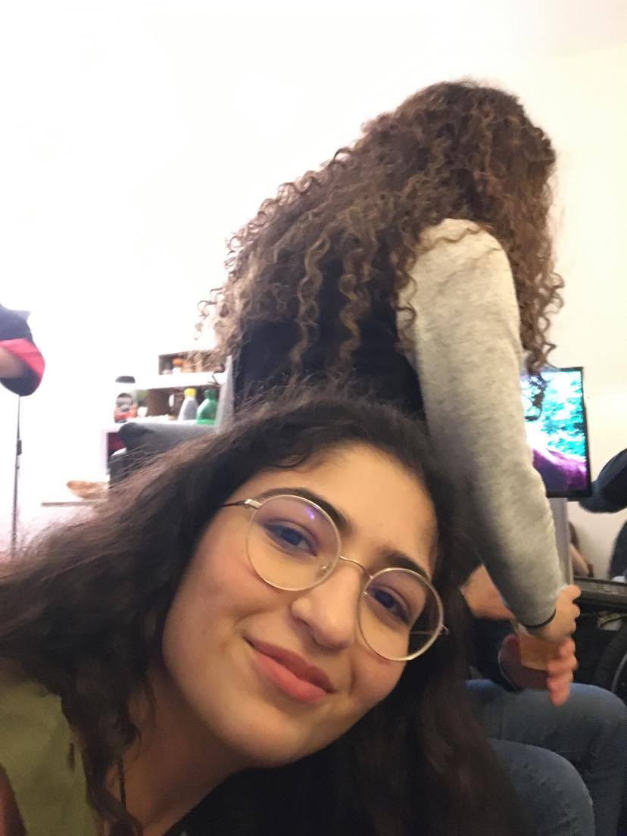
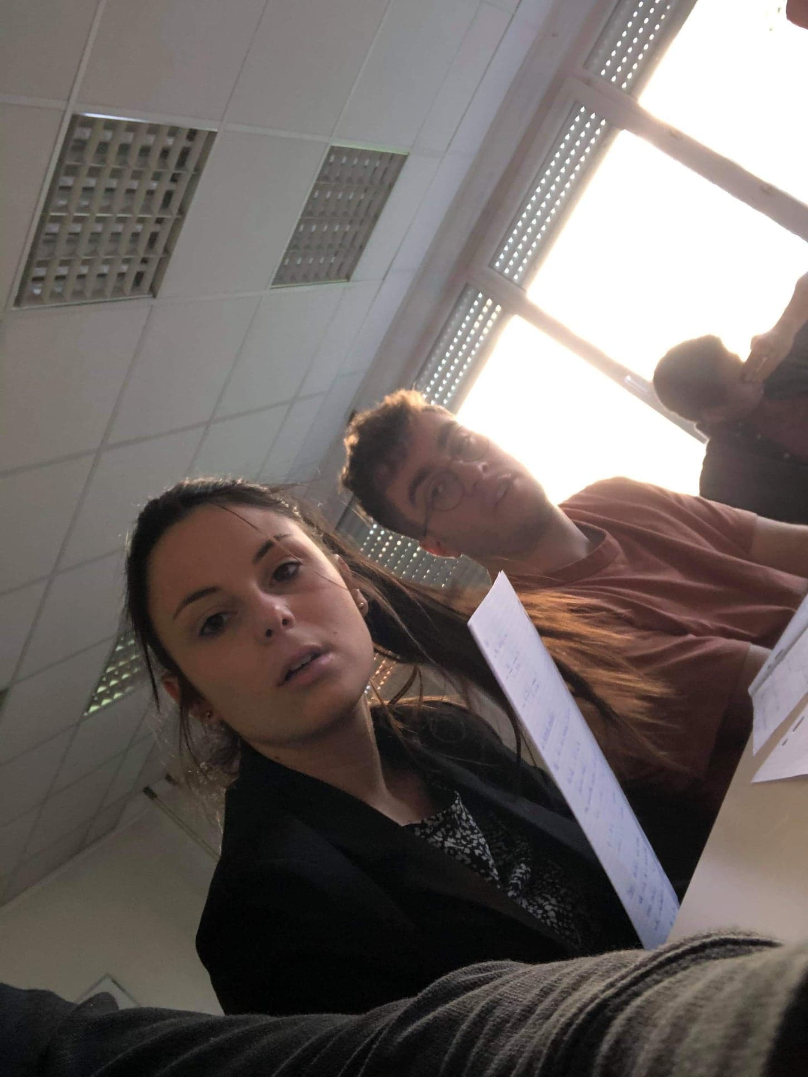

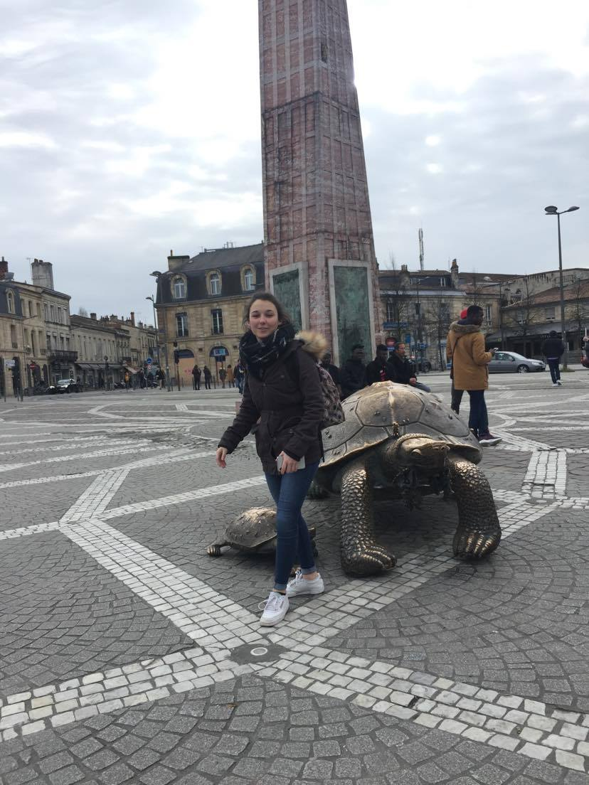
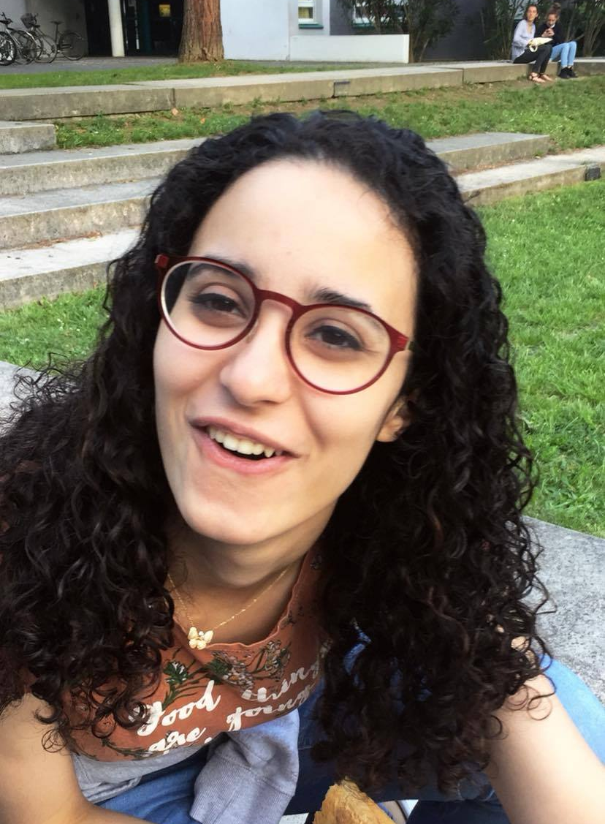

Conclusion
Cécile Pillard
Zineb Bennis
Very recent paper
Morgane Jacquiet
Maxime Doré
Different neural network
Yasmine Debbagh

Slide 23


Conclusion
Thank you for listening
Any questions ?

